Slide 1
Producers

Slide 2
In this Smart Lesson, we will focus on producers. By the end of the lesson, you should be able to:
1. | Describe what a producer is.
2. | Explain how producers make their own food.

Slide 3
Living things within an ecosystem can be broken up into three categories:
1. | Organisms that make their own food.
2. | Organisms that eat other organisms.
3. | Organisms that break down dead things.

Slide 4
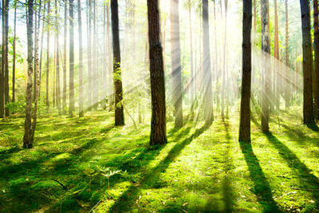
Plants, algae and other singled-celled organisms are known as producers.
Producers are organisms that make their own food by using energy from the Sun.

Slide 5
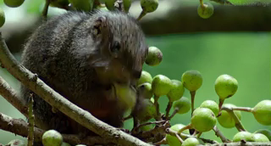
Producers live by capturing energy from the Sun and making all the food matter that sustains animal life.
Other organisms consume producers to gain energy from them. Without producers, other organisms would not be able to survive.

Slide 6
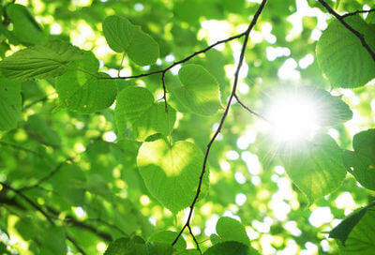
Most producers get their energy from the Sun.
They use the energy from the Sun to make food for themselves.
Photosynthesis is the name of the process used by producers to turn the Sun's energy into food.

Slide 7
Producers use photosynthesis to make their food.
During photosynthesis, producers take in carbon dioxide (CO₂​) and water.
They use the Sun's energy to convert the CO2​ and water into sugar, called glucose, and oxygen.
Producers use glucose as food. The oxygen they produce can be used by other organisms to breathe!

Slide 8
